Slide 1
Dimension Reduction for Big Data
25th June 2018
Devin Nanayakkara

Slide 2
Overview
Dimension Reduction for Big Data
25th June 2018
Introduction
Motivation
Goal
Implementation
Results
Conclusion

Slide 3








Applications
Dimension Reduction for Big Data
25th June 2018
Analytics
Business Intelligence
Infrastructure

Slide 4
Curse of Dimensionality
Dimension Reduction for Big Data
25th June 2018
Data isolation
Notes:
As dimensionality increases, the volume of the space also increases.
More and more samples are required to perform machine learning or statistical analysis.

Slide 5
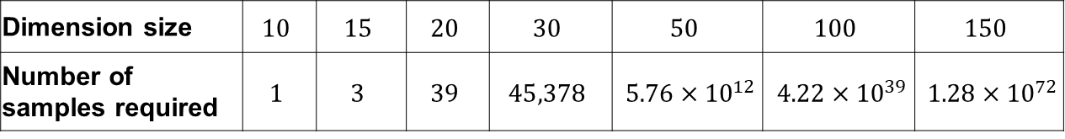
Curse of Dimensionality
Dimension Reduction for Big Data
25th June 2018
Data isolation
Number of training samples required for a K-Nearest Neighbour search algorithm
Dimension size | $$10$$ | $$15$$ | $$20$$ | $$30$$ | $$50$$ | $$100$$ | $$150$$
Number of samples required | $$1$$ | $$3$$ | $$39$$ | $$45,378$$ | $5.76×{10}^{12}$ | $4.22×{10}^{39}$ | $1.28×{10}^{72}$

Slide 6
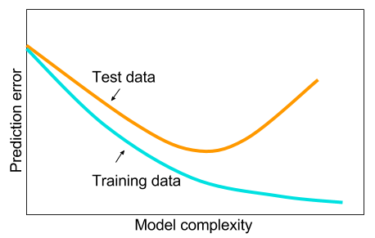
Curse of Dimensionality
Dimension Reduction for Big Data
25th June 2018
Data isolation
Overfitting
Notes:
The complexity of the data increases with the dimensionality.
In a neural networks application, the hidden layers will be very complex.
This leads to…..

Slide 7
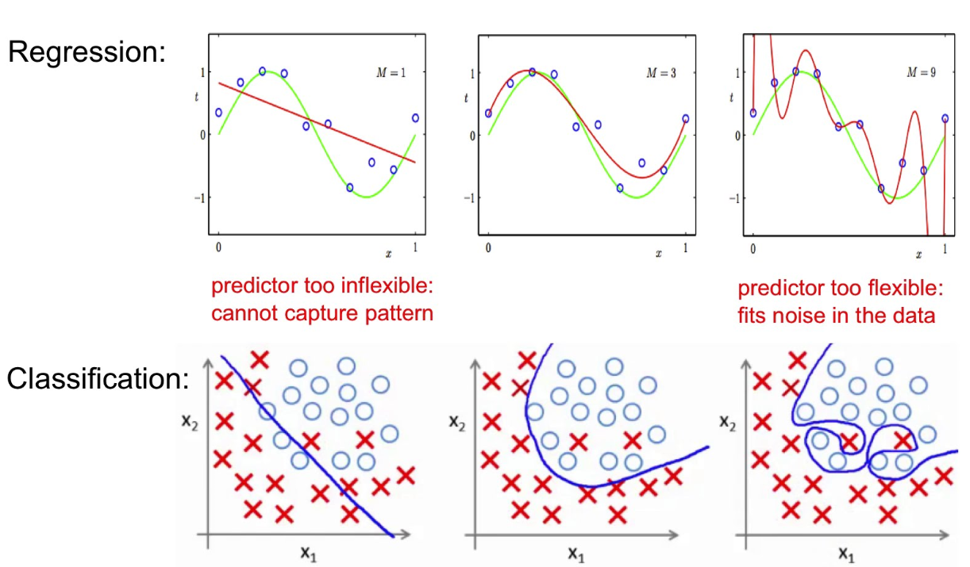
Curse of Dimensionality
Dimension Reduction for Big Data
25th June 2018
Data isolation
Overfitting
False Structure

Slide 8
Curse of Dimensionality
Dimension Reduction for Big Data
25th June 2018
Data isolation
Overfitting
False Structure
Computation difficulty
Time
Complexity
Notes:
A simpler, but sometimes very effective,
way of dealing with high-dimensional data is to reduce the number of dimensions

Slide 9
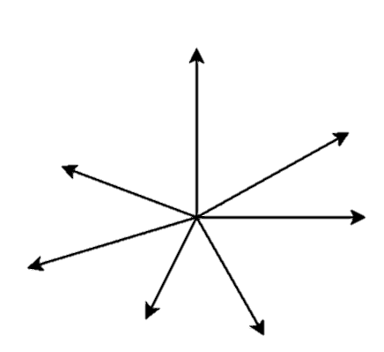
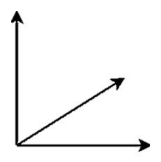



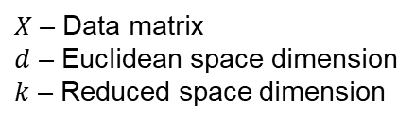


Random Projection (1)
Dimension Reduction for Big Data
25th June 2018
$$Φ$$
$$d>k$$
$X$ in $ℝ^{d}$
$Φ(X)$ in $ℝ^{k}$
Assist applications whose data is represented geometrically in high dimensional vector spaces
$X$ – Data matrix
$d$ – Euclidean space dimension
$k$ – Reduced space dimension

Slide 10
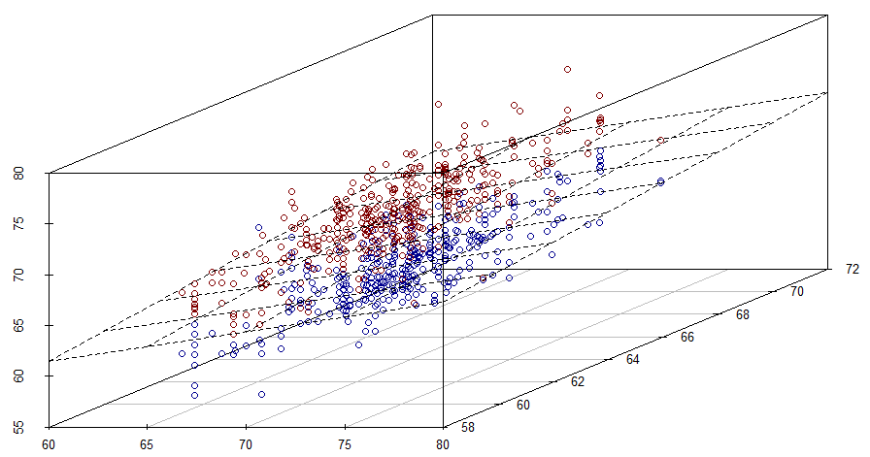
Random Projection (2)
Dimension Reduction for Big Data
25th June 2018

Slide 11
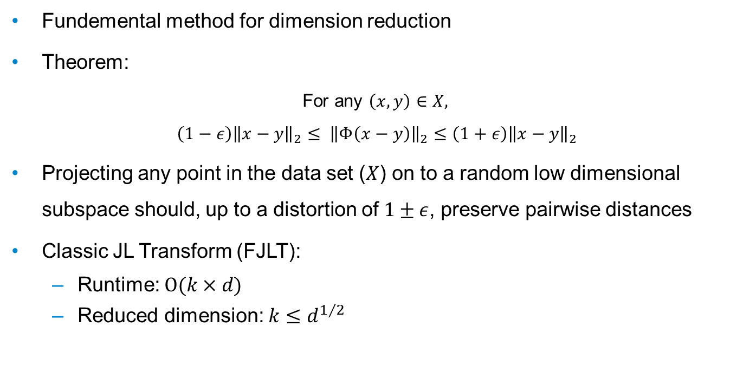
Johnson-Lindenstrauss Transform
Dimension Reduction for Big Data
25th June 2018
Fundemental method for dimension reduction
Theorem:
For any $\left(x,y\right)∈X,$
$$\left(1−ε\right){\left\|x−y\right\|}_{2}≤ {\left\|Φ\left(x−y\right)\right\|}_{2}≤\left(1+ε\right){\left\|x−y\right\|}_{2}$$
Projecting any point in the data set ($X$) on to a random low dimensional subspace should, up to a distortion of $1±ε$, preserve pairwise distances
Classic JL Transform (FJLT):
Runtime: $O(k×d)$
Reduced dimension: $k≤d^{1/2}$

Slide 12
Goal
Dimension Reduction for Big Data
25th June 2018
Implement structured random matrices to speed up the JL transform
Fast JL transforms
Notes:
yielding low-complexity solutions to dimension reduction
implement efficient random projectors for dimension reduction

Slide 13
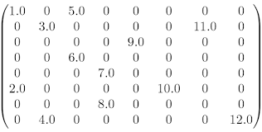
SPARSITY
Dimension Reduction for Big Data
14/12/2017
Why Sparse matrices?

Slide 14
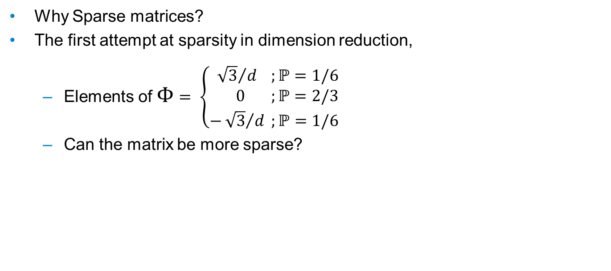
SPARSITY
Dimension Reduction for Big Data
14/12/2017
Why Sparse matrices?
The first attempt at sparsity in dimension reduction,
Elements of $Φ$ $= \left\{\begin{aligned}{ \sqrt{3}}/d ;ℙ=1/6 \\ 0 ;ℙ=2/3 \\ −{\sqrt{3}}/d ;ℙ=1/6\end{aligned} \right.$
Can the matrix be more sparse?

Slide 15


SPARSITY
Dimension Reduction for Big Data
14/12/2017
Why Sparse matrices?
The first attempt at sparsity in dimension reduction,
Elements of $Φ$ $= \left\{\begin{aligned}{ \sqrt{3}}/d ;ℙ=1/6 \\ 0 ;ℙ=2/3 \\ −{\sqrt{3}}/d ;ℙ=1/6\end{aligned} \right.$
Can the matrix be more sparse?
$$\left(\begin{aligned}\begin{matrix}x & 0 & x \\ 0 & x & 0 \\ x & 0 & 0\end{matrix} \begin{matrix}0 & 0 & 0 \\ 0 & x & 0 \\ x & 0 & x\end{matrix} \\ \begin{matrix}0 & 0 & x \\ x & 0 & 0 \\ 0 & x & 0\end{matrix} \begin{matrix}0 & 0 & 0 \\ 0 & 0 & x \\ 0 & x & 0\end{matrix}\end{aligned}\right)$$
$$\left({0 \atop \begin{aligned}0 \\ 0 \\ 1 \\ 0 \\ 0\end{aligned} }\right)$$

Slide 16
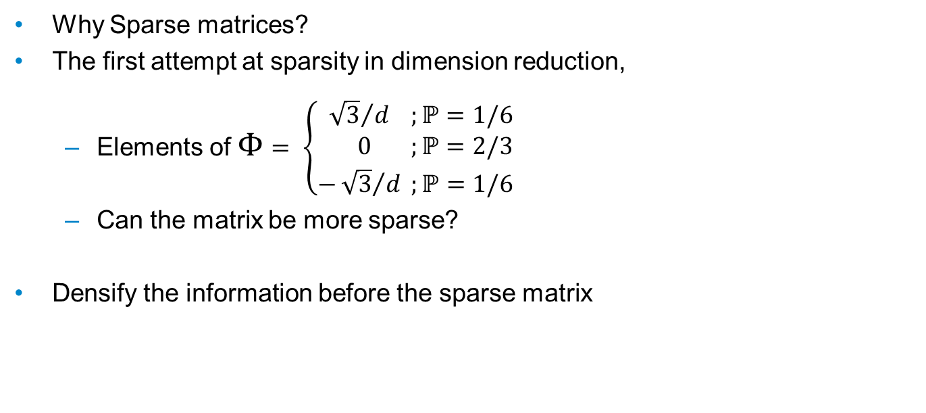
SPARSITY
Dimension Reduction for Big Data
14/12/2017
Why Sparse matrices?
The first attempt at sparsity in dimension reduction,
Elements of $Φ$ $= \left\{\begin{aligned}{ \sqrt{3}}/d ;ℙ=1/6 \\ 0 ;ℙ=2/3 \\ −{\sqrt{3}}/d ;ℙ=1/6\end{aligned} \right.$
Can the matrix be more sparse?
Densify the information before the sparse matrix
$$\left(\begin{aligned}\begin{matrix}x & 0 & x \\ 0 & x & 0 \\ x & 0 & 0\end{matrix} \begin{matrix}0 & 0 & 0 \\ 0 & x & 0 \\ x & 0 & x\end{matrix} \\ \begin{matrix}0 & 0 & x \\ x & 0 & 0 \\ 0 & x & 0\end{matrix} \begin{matrix}0 & 0 & 0 \\ 0 & 0 & x \\ 0 & x & 0\end{matrix}\end{aligned}\right)$$
$$\left({0 \atop \begin{aligned}0 \\ 0 \\ 1 \\ 0 \\ 0\end{aligned} }\right)$$

Slide 17

FAST JL TRANSFORM
Dimension Reduction for Big Data
14/12/2017
$Φ=S . H . D$

Slide 18


FAST JL TRANSFORM
Dimension Reduction for Big Data
14/12/2017
$Φ=S . H . D$
$D_{d×d}$ : Random diagonal matrix with $D_{ii}=\left\{−1,1\right\}$ with probability ½.
$$\left(\begin{matrix}±1 & 0 & 0 \\ 0 & ⋱ & 0 \\ 0 & 0 & ±1\end{matrix}\right)$$

Slide 19
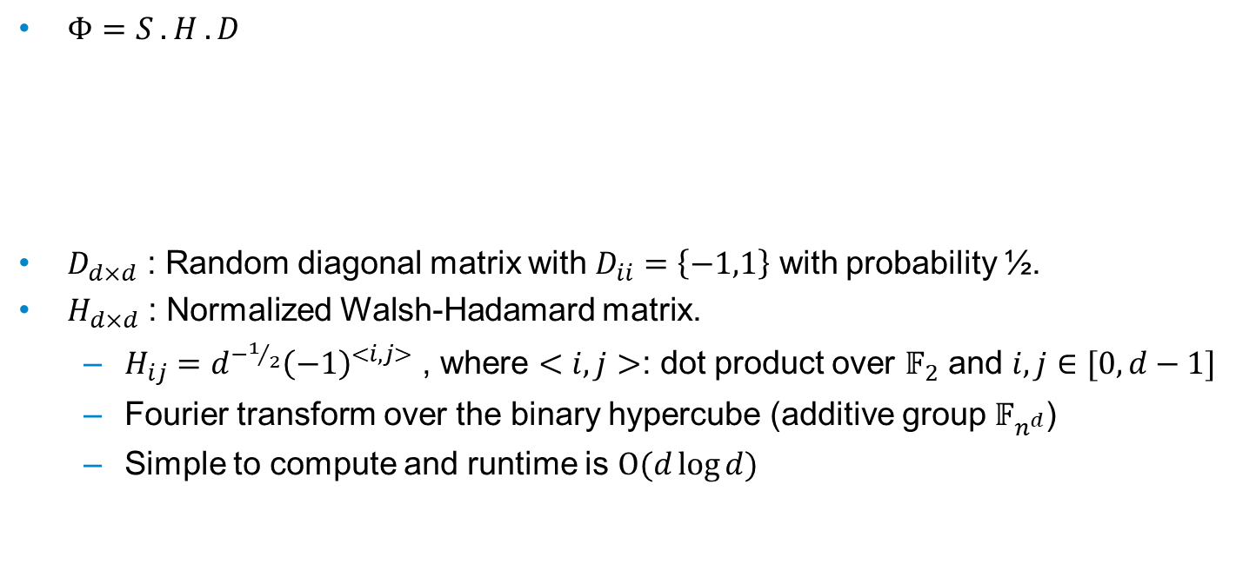
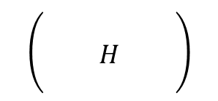
FAST JL TRANSFORM
Dimension Reduction for Big Data
14/12/2017
$Φ=S . H . D$
$D_{d×d}$ : Random diagonal matrix with $D_{ii}=\left\{−1,1\right\}$ with probability ½.
$H_{d×d}$ : Normalized Walsh-Hadamard matrix.
$H_{ij}=d^{−1/2}{\left(−1\right)}^{<i,j>}$ , where $<i,j>$: dot product over $𝔽_{2}$ and $i,j∈[0,d−1]$
Fourier transform over the binary hypercube (additive group $𝔽_{n^{d}}$)
Simple to compute and runtime is $Ο(d\log{d})$
$$\left(\begin{matrix} & & \\ & H & \\ & & \end{matrix}\right)$$
$$\left(\begin{matrix}±1 & 0 & 0 \\ 0 & ⋱ & 0 \\ 0 & 0 & ±1\end{matrix}\right)$$

Slide 20


FAST JL TRANSFORM
Dimension Reduction for Big Data
14/12/2017
$Φ=S . H . D$
$D_{d×d}$ : Random diagonal matrix with $D_{ii}=\left\{−1,1\right\}$ with probability ½.
$H_{d×d}$ : Normalized Walsh-Hadamard matrix.
$S_{k×d}$ : Sparse matrix.
$P_{ij} \sim N(0,1/q)$, with probability $q$ and $P_{ij}=0$, with probability $(1−q)$
$q=\min\left\{Θ\left(\frac{ε^{p−2}\log^{p}{n}}{d}\right),1\right\}$, $p∈\{1,2\}$
Required sparsity $≈$ $k^{3}$ non-zero entries
n: size of the data matrix X, i.e. number of points
$$\left(\begin{matrix} & & \\ & H & \\ & & \end{matrix}\right)$$
$$\left(\begin{matrix}±1 & 0 & 0 \\ 0 & ⋱ & 0 \\ 0 & 0 & ±1\end{matrix}\right)$$
$$\left(\begin{matrix}? & & ? \\ & ? & \end{matrix}\right)$$

Slide 21
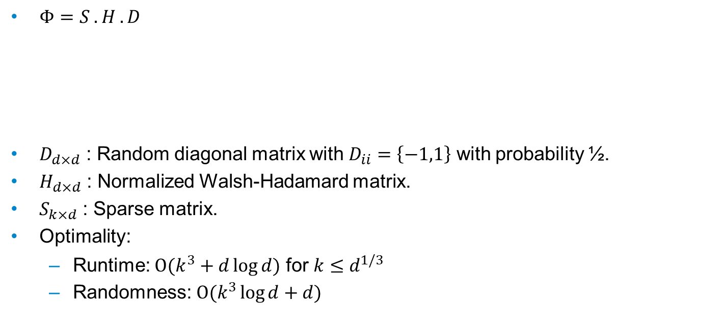
FAST JL TRANSFORM
Dimension Reduction for Big Data
14/12/2017
$Φ=S . H . D$
$D_{d×d}$ : Random diagonal matrix with $D_{ii}=\left\{−1,1\right\}$ with probability ½.
$H_{d×d}$ : Normalized Walsh-Hadamard matrix.
$S_{k×d}$ : Sparse matrix.
Optimality:
Runtime: $Ο(k^{3}+d\log{d})$ for $k≤d^{1/3}$
Randomness: $Ο(k^{3}\log{d}+d)$
$$\left(\begin{matrix} & & \\ & H & \\ & & \end{matrix}\right)$$
$$\left(\begin{matrix}±1 & 0 & 0 \\ 0 & ⋱ & 0 \\ 0 & 0 & ±1\end{matrix}\right)$$
$$\left(\begin{matrix}? & & ? \\ & ? & \end{matrix}\right)$$

Slide 22
INTRODUCTION (2)
Dimension Reduction for Big Data
13/12/2017
Random projection first introduced in 1980’s by Johnson and Lindenstrauss
The Johnson-Lindenstrauss Transform:
For any $\left(x,y\right)∈X$, $\left(1−ε\right){\left\|x−y\right\|}_{2}≤ {\left\|Φ\left(x−y\right)\right\|}_{2}≤\left(1+ε\right){\left\|x−y\right\|}_{2}$
Projecting the points in the data set ($X$) on to a random low dimensional subspace should, up to a distortion of $1±ε$, preserve pairwise distances
Fast JL Transform (FJLT): first attempt of sparsity on JL
Runtime: $Ο\left(\max\left\{d\log{d},k^{3}\right\}\right)$
For $k$ in $[Ω\left(\log{d}\right), Ο(d^{1/2})]$

Slide 23
FJLT with Coding Theory
Dimension Reduction for Big Data
13/12/2017
Welsh-Hadamard matrix
$H_{ij}=d^{−1/2} {\left(−1\right)}^{<i,j>}$ for all $i,j∈[0,d−1]$, where $<i,j>$ is the dot product over $𝔽_{2}$
Encodes the Fourier transform over the binary hypercube
$x ⟼Hx$, for any $x∈l_{2}^{d}$, can be computed in $Ο\left(d\log{d}\right)$ and is isomorphic
Define: $A∈ℝ^{m×d}$ is a code matrix is equal to some row of $H$ times $\sqrt{d/m}$
Equivalent to a dual BCH code of designed distance 3.

Slide 24
MECHANISM (NEW $Φ$)
Dimension Reduction for Big Data
13/12/2017
$Φ=B . D_{1} . H . D_{3} … H . D_{1/γ}$ where $γ$ is an arbitrary small constant
$D_{d×d}$ : Diagonal matrix with $D_{ii}=\left\{−1,1\right\}$ with probability ½.
$B_{k×d}$ : Error correction matrix containing deterministic non-trivial choice of rows of H

Slide 25
MECHANISM (NEW $Φ$)
Dimension Reduction for Big Data
13/12/2017
$Φ=B . D_{1} . H . D_{3} … H . D_{1/γ}$ where $γ$ is an arbitrary small constant
$D_{d×d}$ : Diagonal matrix with $D_{ii}=\left\{−1,1\right\}$ with probability ½.
$B_{k×d}$ : Error correction matrix containing deterministic non-trivial choice of rows of H
Optimality?
Runtime: $Ο(d\log{k})$ ($Ο\left(\max\left\{d\log{d},k^{3}\right\}\right)$for sparse JL)
For $k≤d^{1/2−γ}$ ($d^{1/2}$ for sparse JL)

Slide 26
MECHANISM (NEW $Φ$)
Dimension Reduction for Big Data
13/12/2017
$Φ=B . D_{1} . H . D_{3} … H . D_{1/γ}$ where $γ$ is an arbitrary small constant
$D_{d×d}$ : Diagonal matrix with $D_{ii}=\left\{−1,1\right\}$ with probability ½.
$B_{k×d}$ : Error correction matrix containing deterministic non-trivial choice of rows of H
Optimality?
Runtime: $Ο(d\log{k})$ ($Ο\left(\max\left\{d\log{d},k^{3}\right\}\right)$for sparse JL)
For $k≤d^{1/2−γ}$ ($d^{1/2}$ for sparse JL)
How?
Observing the $l_{4}$-norm, ${\left\|HDx\right\|}_{4}≤ {\left\|x\right\|}_{4}d^{−γ}+d^{−1/4}$, and after $1/γ$ steps, for all $x∈X$, ${\left\|x\right\|}_{4}≤d^{−1/4}$

Slide 27
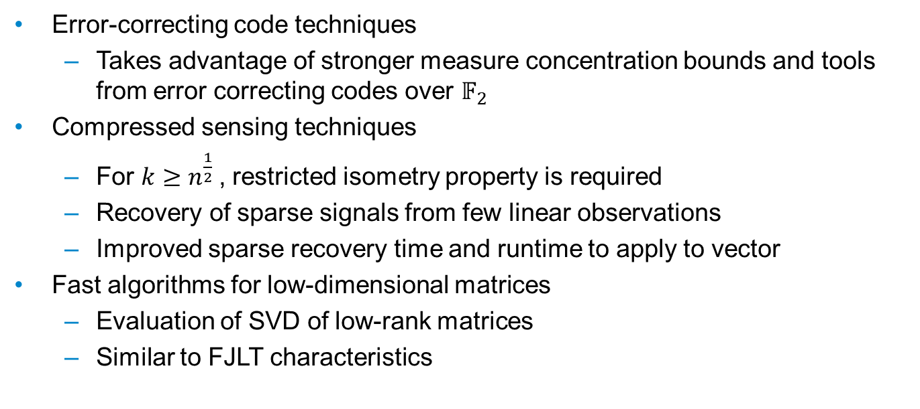
FURTHER RESEARCH
Dimension Reduction for Big Data
14/12/2017
Error-correcting code techniques
Takes advantage of stronger measure concentration bounds and tools from error correcting codes over $𝔽_{2}$
Compressed sensing techniques
For $k≥n^{\frac{1}{2}}$, restricted isometry property is required
Recovery of sparse signals from few linear observations
Improved sparse recovery time and runtime to apply to vector
Fast algorithms for low-dimensional matrices
Evaluation of SVD of low-rank matrices
Similar to FJLT characteristics

Slide 28
THANK YOU
Dimension Reduction for Big Data
14/12/2017

Slide 29
Dimension Reduction for Big Data
14/12/2017

Slide 30
APPENDIX
14/12/2017
Devin Nanayakkara

Slide 31
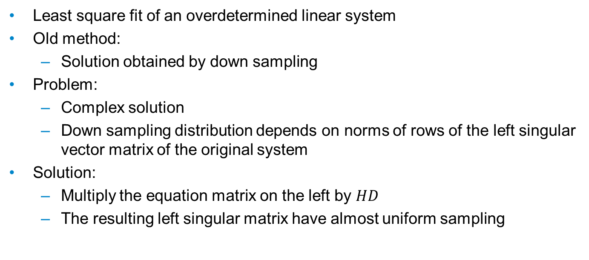
$$ℓ_{2} Regression$$
Appendix
14/12/2017
Least square fit of an overdetermined linear system
Old method:
Solution obtained by down sampling
Problem:
Complex solution
Down sampling distribution depends on norms of rows of the left singular vector matrix of the original system
Solution:
Multiply the equation matrix on the left by $HD$
The resulting left singular matrix have almost uniform sampling

